Slide 1
Starter
A man has a choice of five ties – 2 red, 1 black and 2 spotty. He also has a choice of five jumpers – 3 black, 1 red and 1 grey. The sample space diagram below shows the possible combinations he can have.
 | Red (r) | Red (r) | Black (b) | Spotty (s) | Spotty (s)
Black (B) | Br | Br | Bb | Bs | Bs
Black (B) | Br | Br | Bb | Bs | Bs
Black (B) | Br | Br | Bb | Bs | Bs
Red (R) | Rr | Rr | Rb | Rs | Rs
Grey (G) | Gr | Gr | Gb | Gs | Gs
Calculate the probability of the man wearing:
A red jumper b) A spotty tie
Something black d) Nothing red
e) Matching jumper and tie
= 1/5
= 17/25
= 5/25 or 1/5
= 2/5
= 12/25

Slide 2
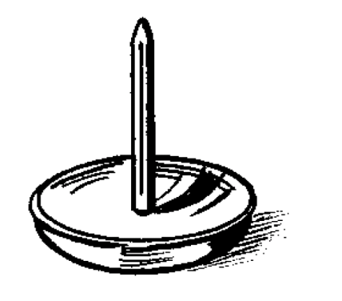
A drawing pin is repeatedly dropped in an experiment to see which way up it will land. Here are the results:
Outcome | Frequency
Point up | 15
Point down | 5
What is the probability that it will land point up?
A
B
10/20 | 5/20
1/4 | 3/4
C
D

Slide 3
A drawing pin is repeatedly dropped in an experiment to see which way up it will land. Here are the results:
Outcome | Frequency
Point up | 15
Point down | 35
What is the probability that it will land point down?
A
B
35/50 | 8/10
15/50 | 35/40
C
D

Slide 4

A coin is repeatedly thrown 60 times in an experiment to see which way up it will land. Here are the results of the experiment:
Outcome | Frequency
Heads | 27
Tails | 33
What is the probability that it will land head up?
A
B
33/60 | 27/60
35/50 | 10/20
C
D

Slide 5
Here are the results of a survey of cars passing a school:
Colour | Number of cars
Red | 3
Black | 10
Silver | 15
Other | 2
What is the probability of the next car passing the school being silver? Simplify your answer.
A
B
3/30 | 25/30
15/10 | 1/2
C
D

Slide 6
Here are the results of a survey of cars passing a school:
Colour | Number of cars
Red | 3
Black | 10
Silver | 15
Other | 2
What is the probability of the next car passing the school being black? Simplify your answer.
A
B
2/30 | 1/10
1/3 | 10/30
C
D

Slide 7
Molly asked number of people about their age and recorded it in a table.
Age Group | Number of People
0 - 20 | 15
21 – 40 | 24
41 – 60 | 18
60 + | 23
What is the experimental probability that the next person Molly asks is aged 21 - 40? Simplify your answer.
A
B
15/80 | 3/10
39/80 | 24/80
C
D

Slide 8
Molly asked number of people about their age and recorded it in a table.
Age Group | Number of People
0 - 20 | 15
21 – 40 | 24
41 – 60 | 18
60 + | 23
What is the experimental probability that the next person Molly asks is aged over 40?
A
B
41/80 | 18/80
39/80 | 23/80
C
D

Slide 9
An ice cream shop recorded the number of customers purchasing ice creams of each of the four flavours available.
Flavour | Number of Customers
Vanilla | 12
Chocolate | 18
Strawberry | 9
Mint | 11
What is the experimental probability that the next customer will purchase a mint ice cream?
A
B
18/50 | 11/40
11/50 | 18/40
C
D

Slide 10
An ice cream shop recorded the number of customers purchasing ice creams of each of the four flavours available.
Flavour | Number of Customers
Vanilla | 12
Chocolate | 18
Strawberry | 9
Mint | 11
What is the experimental probability that the next customer will purchase a vanilla or chocolate ice cream?
A
B
18/50 | 20/50
12/50 | 30/50
C
D

Slide 11
Here are the results of a survey of cars passing a school:
Colour | Number of cars
Red | 3
Black | 10
Silver | 15
Other | 2
What is the probability of the next car passing the school being red or other? Simplify your answer.
A
B
5/30 | 1/5
6/30 | 1/6
C
D

Slide 12
Relative Frequency
In most events, it is difficult to accurately predict the probability of an event happening.
When there is no theory behind the probability of an event happening, we use relative frequency to calculate probabilities.
Because it is often calculated after performing experiments, it is often called experimental probability.

Slide 13
Relative Frequency
The probability of picking a vegetarian at random from a group of people can be found using relative frequency.
The easiest way to calculate this probability is by conducting an experiment.

Slide 14
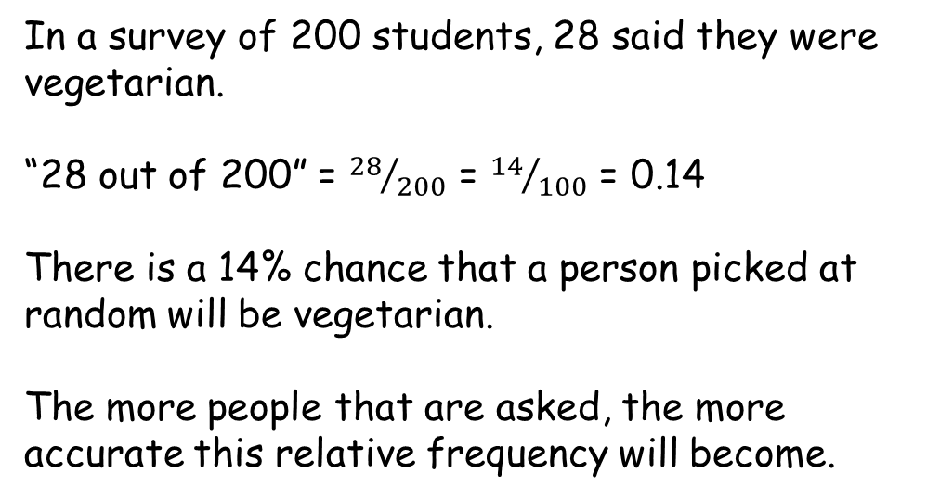
Relative Frequency
In a survey of 200 students, 28 said they were vegetarian.
“28 out of 200” = ${28}/{200}$ = ${14}/{100}$ = 0.14
There is a 14% chance that a person picked at random will be vegetarian.
The more people that are asked, the more accurate this relative frequency will become.

Slide 15
Relative Frequency
Fred records the colour of 100 cars that pass his house. His results are shown below.
Calculate the relative frequency/experimental probability of each colour.
What is the probability that the next car to pass his house will be:
  red?
  Blue?
  Not black?
On an average day, 3500 cars pass Fred’s house. Based on his results, how many of these 3500 would we expect to be silver?
Colour | Red | Blue | Silver | Black | Other
Frequency | 10 | 15 | 38 | 32 | 5
Colour | Red | Blue | Silver | Black | Other
Frequency | 10 | 15 | 38 | 32 | 5
Relative Frequency | 0.1 | 0.15 | 0.38 | 0.32 | 0.05
= P(red) = 0.1
= P(blue) = 0.15
= P(not black) = 1 – 0.32 = 0.68
= 0.38 x 3500 = 1330 cars would be expected to be silver

Slide 16
Pair Activity
Roll your die 50 times and record your results in the tally graph below.
Number | Tally | Frequency | Observed Relative Frequency | Expected Relative Frequency
1 |  |  |  | 0.17
2 |  |  |  | 0.17
3 |  |  |  | 0.17
4 |  |  |  | 0.17
5 |  |  |  | 0.17
6 |  |  |  | 0.17
When you have completed your 50 rolls tell me your observations
Calculate the relative frequency of each number for your experiment

Slide 18
Answers
1ai) 5/20 or 1/4 ii) 4/20 or 1/5 iii) 17/20
1bi) 20 ii) 12
2ai) 160/200 or 4/5 ii) 40/200 or 1/5
2bi) 64 ii) 256 iii) 320
3ai) 20/54 or 10/27 ii) 36/54 or 2/3
3bi) 30 ii) 74
iii) 296 iv) 136

